Slide 1




RAZORPAY AI BUILDATHON
INFERPROMPT
EVIDENCE-GROUNDED MULTI-LLM PAYMENT RISK INTELLIGENCE
Deterministic Evidence + Multi-LLM Analysis
Consensus + Reasoning Comparison
Presenter: Ritesh Kumar Sinha
Inferprompt live - inferprompts.vercel.app

Slide 2



02
PROBLEM STATEMENT
CAN WE REALLY TRUST AN AI-GENERATED RISK DECISION?
Modern LLMs can analyze payment transactions, but tHEY CAN ALSO:
MISINTERPRET MCC CODES
INVENT MERCHANT CHARACTERISTICS
CONTRADICT ACTUAL TRANSACTION FIELDS
PRODUCE INCONSISTENT RISK SCORES
GIVE DIFFERENT RECOMMENDATIONS FOR THE SAME TRANSACTION
PROVIDE REASONING THAT IS DIFFICULT TO COMPARE OBJECTIVELY
THE CORE PROBLEM
AN LLM SHOULD PROVIDE AN OPINION — NOT BLINDLY BECOME THE SOURCE OF TRUTH.

Slide 3

THE SOLUTION
03
INFERPROMPT: MULTI-LAYER RISK ARCHITECTURE
🤖 Multiple Independent LLMs analyzing the same transaction
🔢 Transparent Deterministic Risk Baseline (rule-based, explainable)
✅ Evidence Validation against canonical merchant & MCC data
📊 Consensus Analytics measuring agreement across models
🔍 ABTD Reasoning Comparison for explainability
⚖️ Final Decision Engine: hard evidence overrides AI opinion
"AI PROVIDES AN OPINION. EVIDENCE PROVIDES THE TRUTH. INFERPROMPT COMBINES BOTH."

Slide 4
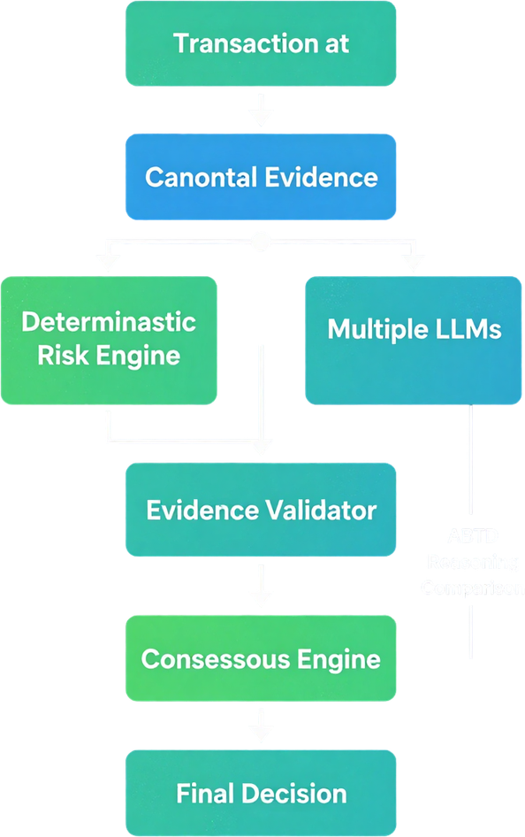


HOW IT WORKS
04

Slide 5

05
TRANSACTION INTELLIGENCE:
Inputs
📥 Core Transaction Fields:
• Amount, currency, country, timestamp
• Merchant verification + MCC code
• Merchant age + payment method
• KYC status + payment verification
🔍 Contextual Signals:
• Device fingerprint + failed attempts
• Previous transaction history
• IP country vs user country mismatch
• Offer context + behavioral metadata

Slide 6

06
INFERPROMPT RISK SCORE
📊 Risk Factors (Prototype Heuristic)
🖥️ New device detected
❌ Multiple failed attempts
🆕 New / unverified merchant
📍 Location mismatch (IP vs country)
🌙 Night-time transaction
💰 Amount anomaly detected
🚦 Thresholds & Actions
LOW (0–30) → ✅ ALLOW
MEDIUM (31–60) → 🔍 REVIEW
HIGH (61–80) → ⚠️ REVIEW / BLOCK
CRITICAL (81–100) → 🚫 BLOCK
⚠️ DISCLAIMER: THIS IS A TRANSPARENT, RULE-BASED PROTOTYPE HEURISTIC — NOT A PRODUCTION-CERTIFIED FRAUD DETECTION MODEL.

Slide 7
WHAT IS ABTD?
07
Anchor-Based Token Diff (ABTD)
Problem
Traditional LCS compares complete token sequences with O(n·m) time and space. Long LLM reasoning outputs can therefore become expensive to compare.
How ABTD Works
1. Tokenize — O(n + m)
Split text into word and punctuation tokens using /\w+|[^\w\s]/g.
2. Build Frequency Maps — O(n + m)
Count occurrences of every token in both outputs.
3. Find Unique Anchors — O(n + m)
Identify tokens appearing exactly once in both texts.
These provide unambiguous synchronization points.
4. Order Anchors with LIS — O(k log k)
Longest Increasing Subsequence prevents crossing/invalid token alignments.
5. Diff Between Anchors
Apply LCS only to the smaller segments between anchors.
6. LCS Fallback
If no useful anchors exist, ABTD gracefully falls back to classic LCS.

Slide 8

08
EVIDENCE VALIDATION
⚖
✅ Supported Evidence
• MCC 5814 = Fast Food
• Bidi merchant verified
• Wallet payment method
• KYC status: verified
• Merchant age: known
❌ Rejected Claims
"Tobacco-related Business"
→ No canonical support
"High-risk merchant"
→ Contradicts KYC data

Slide 9
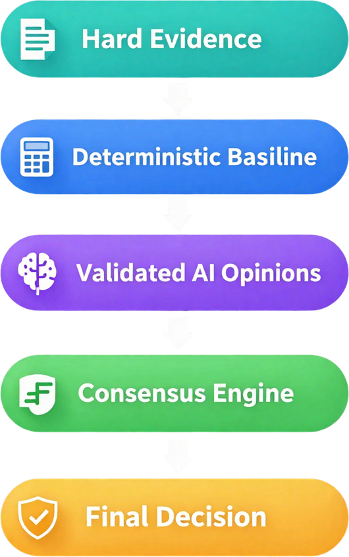


FINAL DECISION ARCHITECTURE
10

Slide 10
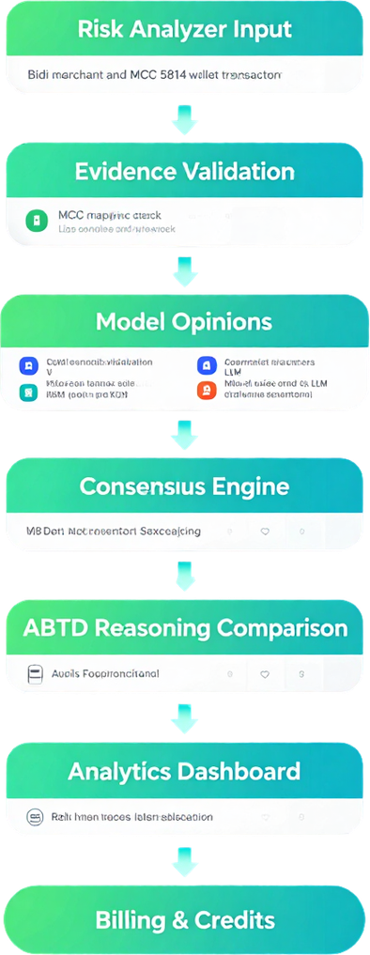


12
LIVE DEMO SCENARIO

Slide 11
11
PLATFORM & RELIABILITY
🔐 Security & Auth
🛡️ JWT Authentication:
• MongoDB-backed user isolation
• Atomic credits system
💳 Razorpay Test Mode:
• Idempotent payment handling
• Webhook-safe transactions
⚙️ Infrastructure Features
SSE streaming for real-time responses
Analytics & usage tracking
Bounded history per user session
Scalable multi-tenant architecture

Slide 12

13
WHY INFERPROMPT ?
⚠️ Naive Approach
Transaction → LLM → Decision
Single model, no validation
Opaque reasoning
No evidence grounding
Blind trust in AI output
No disagreement detection
No explainability
Hallucinated merchant data
Inconsistent risk scores
✅ InferPrompt Pipeline
Transaction → Evidence → Multi-LLM
Deterministic risk baseline
Evidence validation layer
Consensus analytics
ABTD reasoning comparison
Disagreement visibility
Full explainability
MCC-grounded merchant facts
Final decision engine

Slide 13
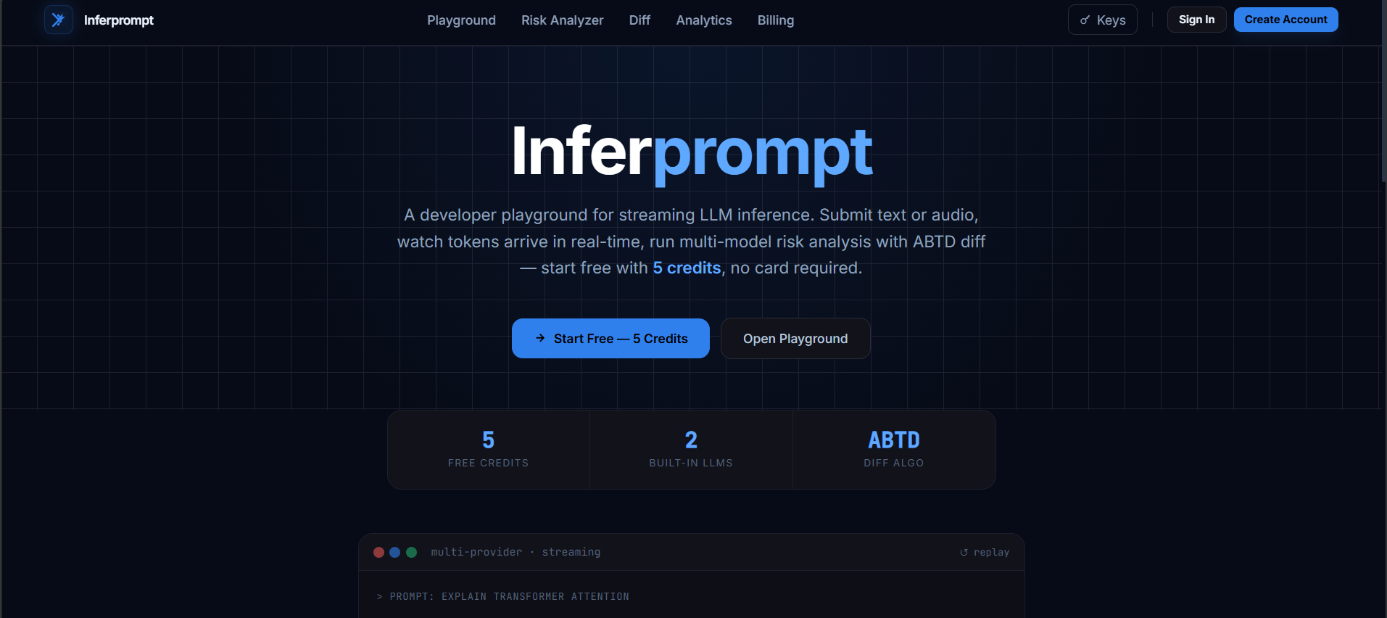

Slide 14
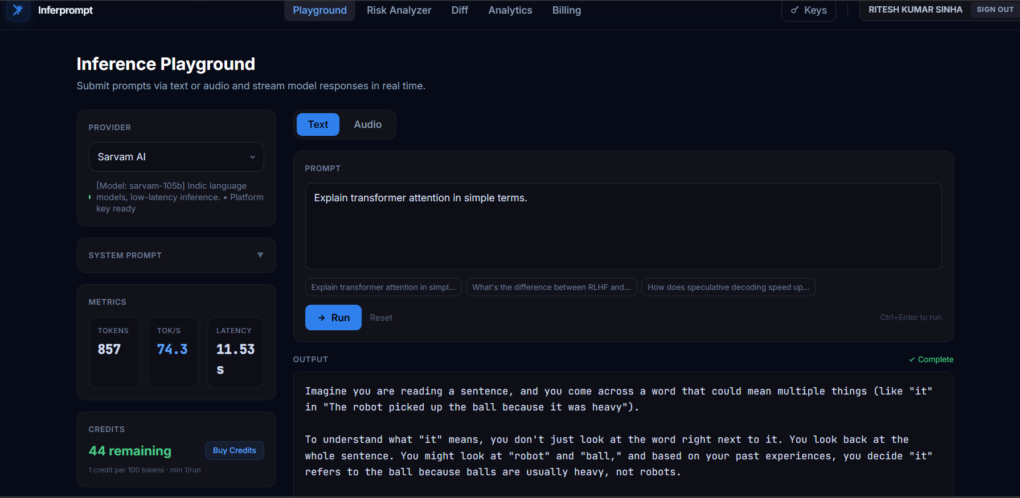

Slide 15
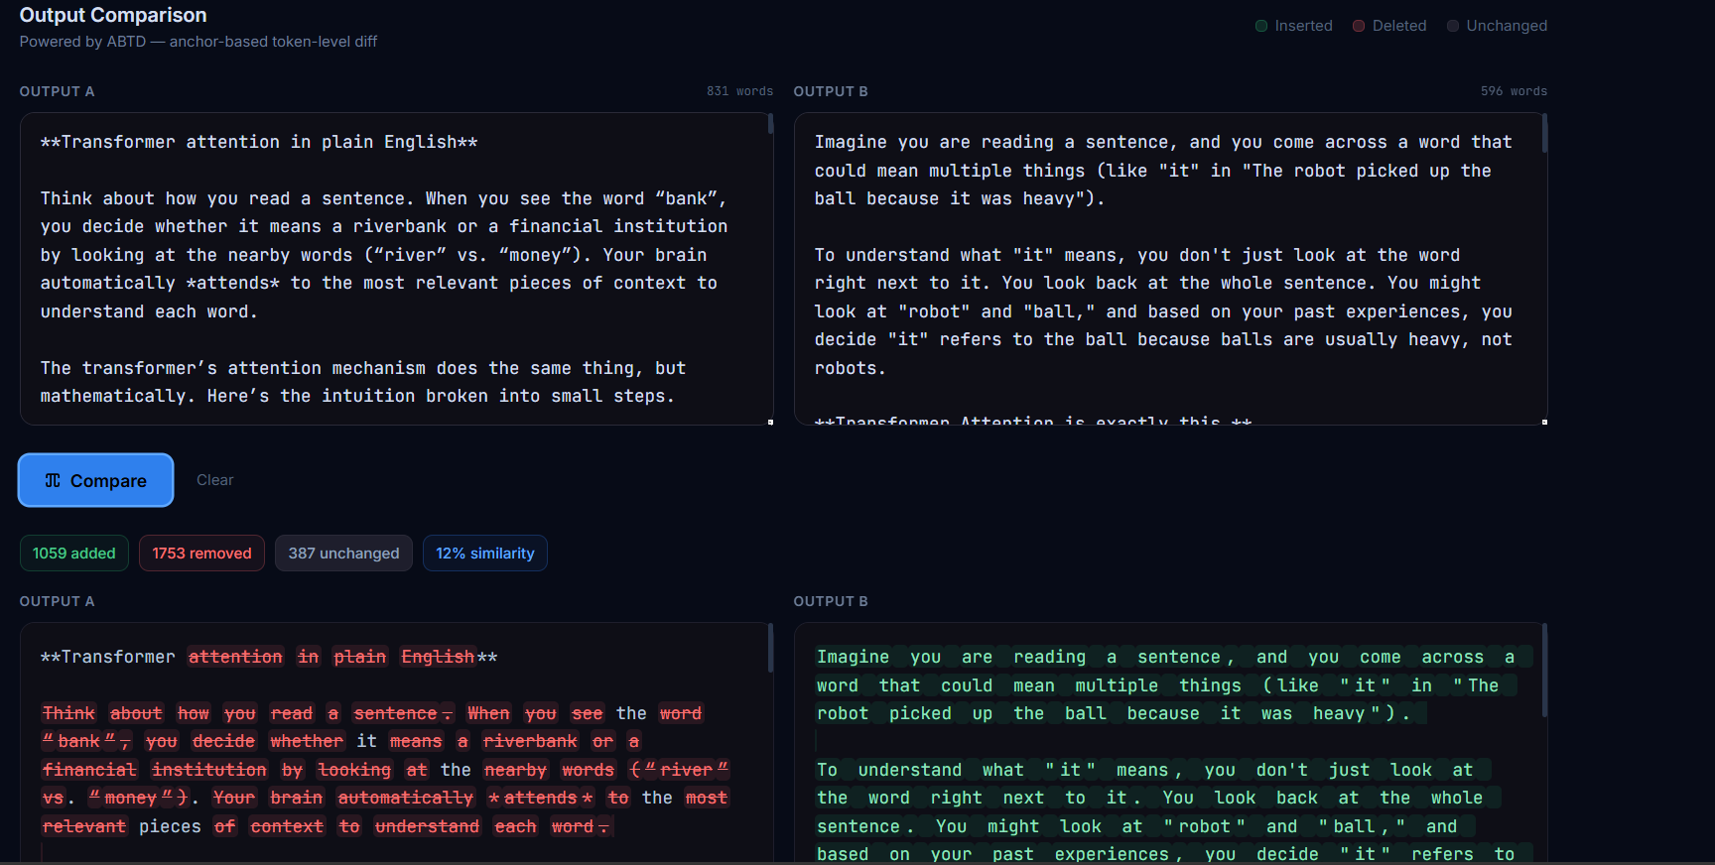

Slide 16
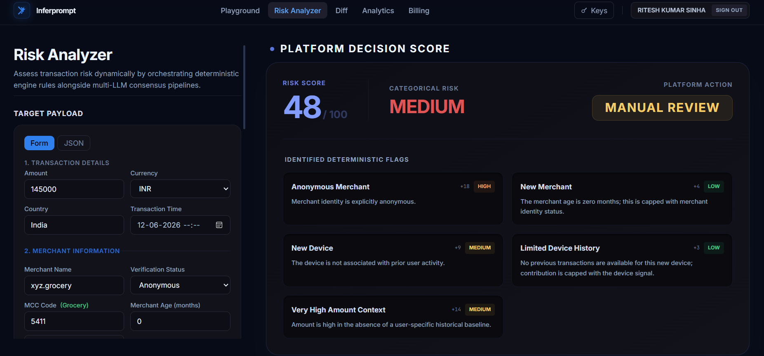

Slide 17
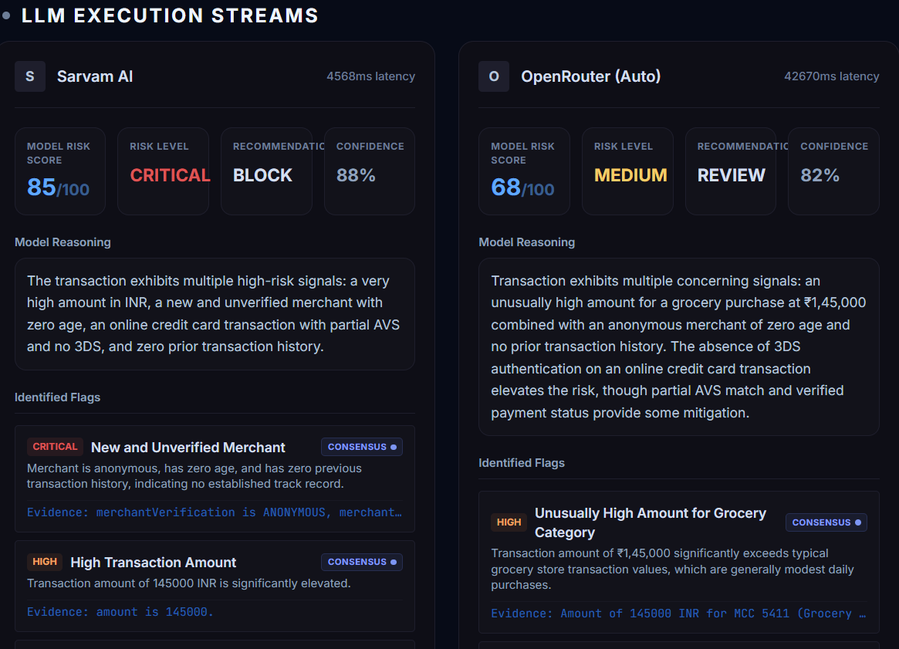

Slide 18
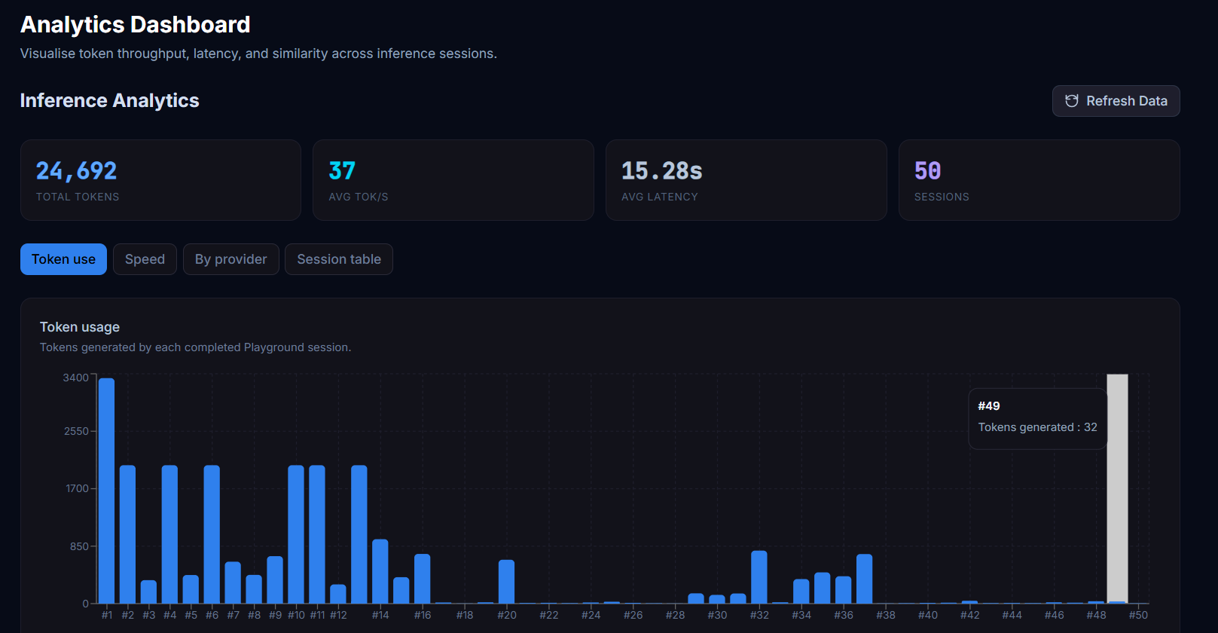

Slide 19
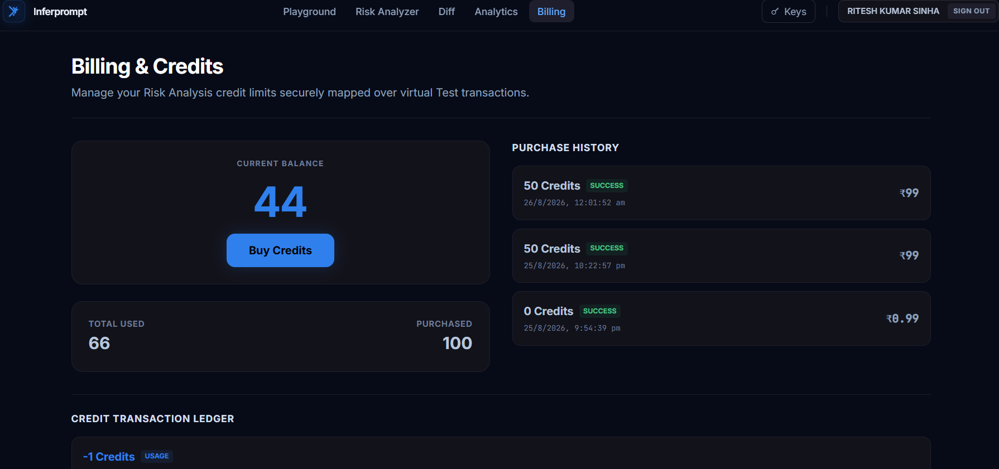

Slide 20
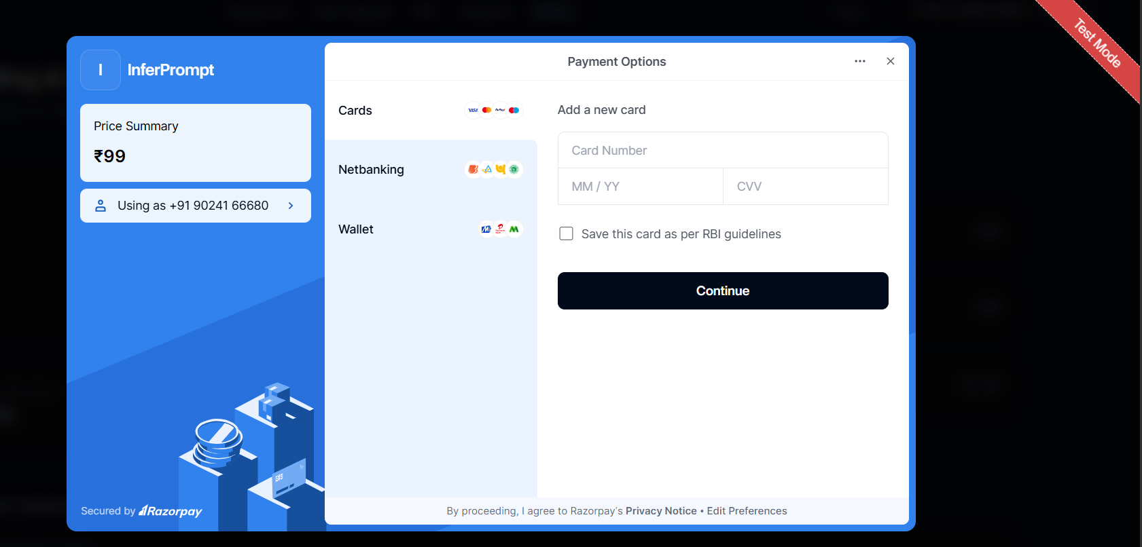

Slide 21
Thank You!

